Slide 1

NAME of Contraption Here
Kenneth Kinderwater
IoT 16 Midterm 1
July 9th 2025

Slide 2
INTRODUCTION
Thanks to ….
Inspiration ….

Slide 3
Show of Force
Background
SOMETHING
Logic
Design
Version 2

Slide 4
What It can do (Show OFF)
Secure the room
Control the room
Wake up to save the day
Temperature Read

Slide 5
Background
Menu Heavy
Switch Case – set Case (menu) pages
If statement to select menu
Display functions- repeated refresh of highlighted selection
Screen Flashing, too many Display functions
Modulus function- Allowed to control scroller location
Return to previous screen
Return option

Slide 6
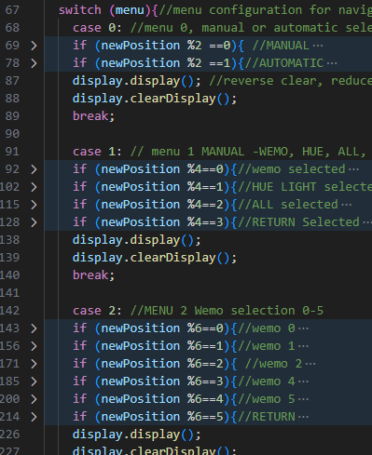
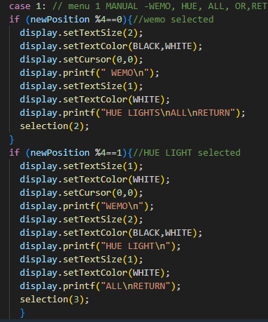
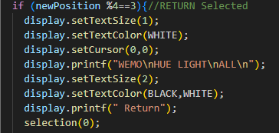
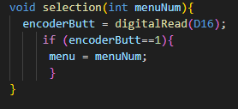
Switch(Case)
Display
Return

Slide 7
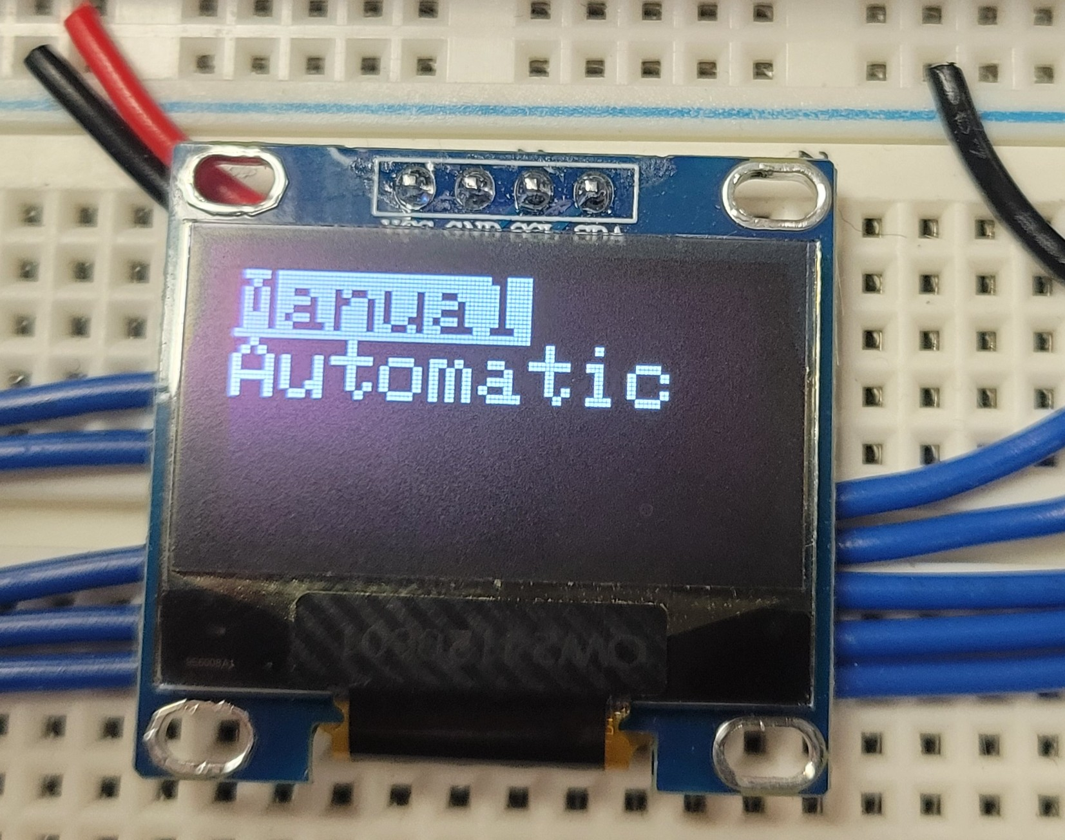
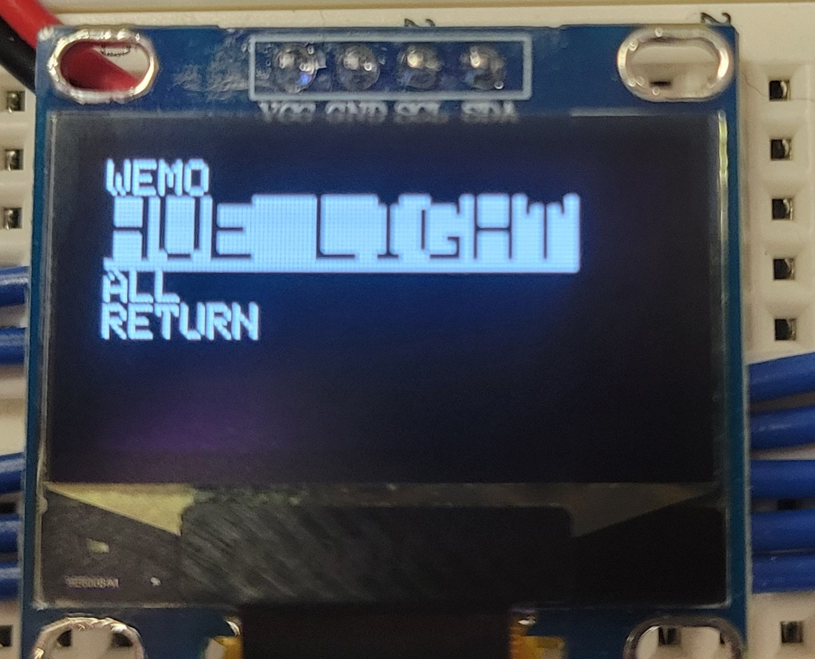
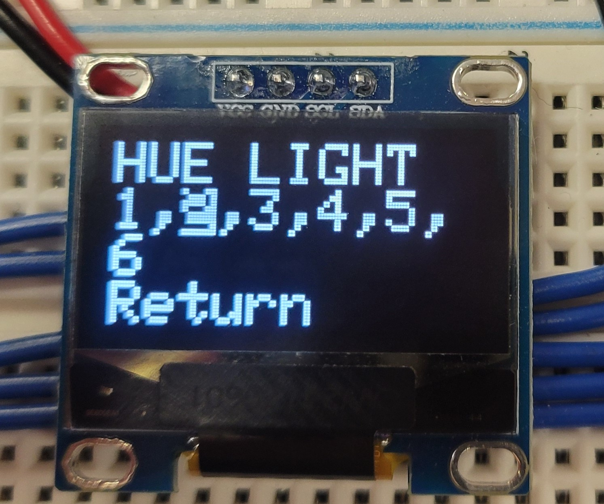
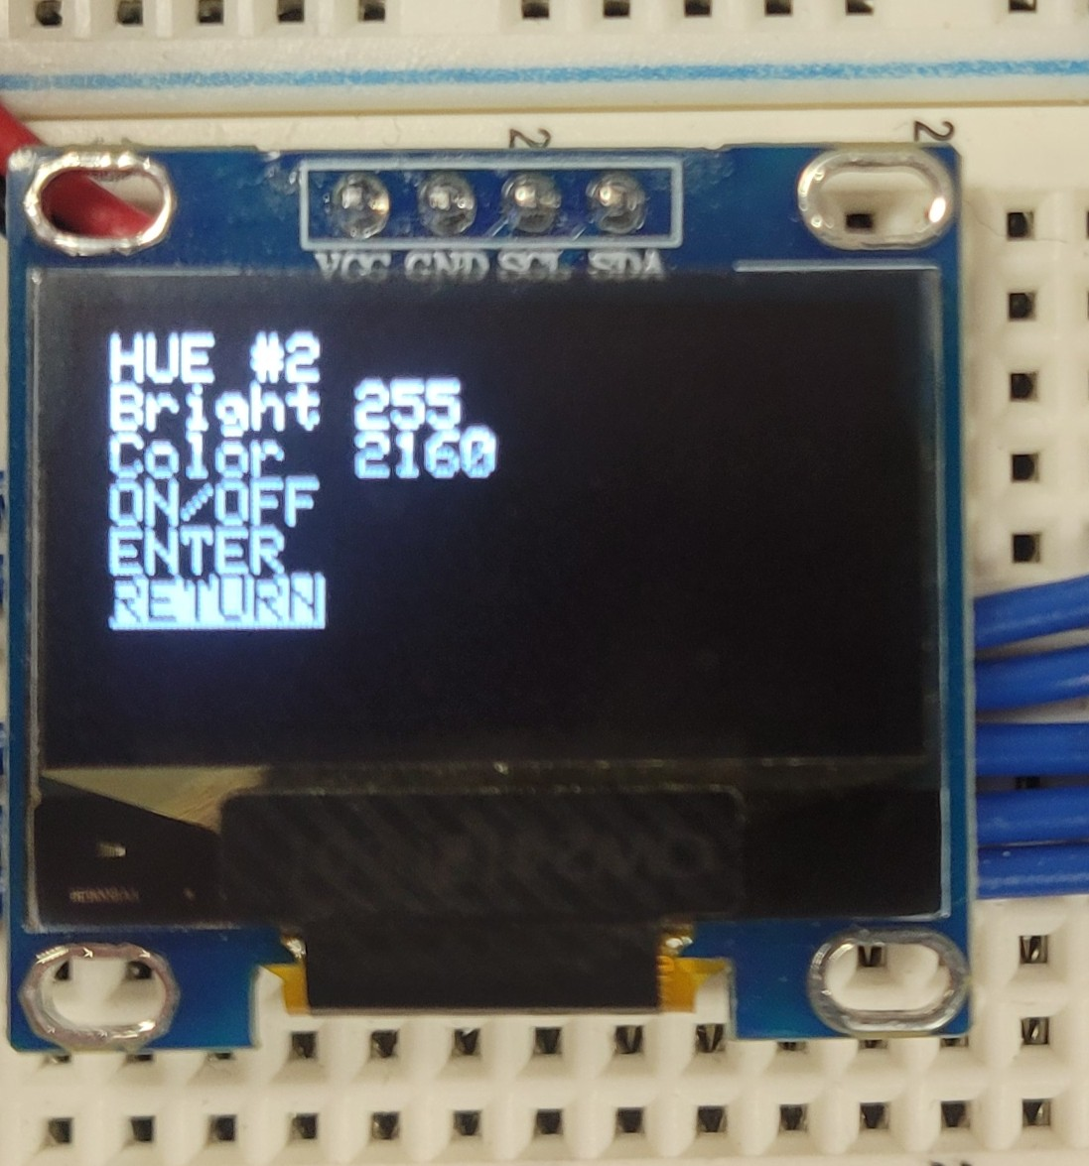
MENU FUNCTIONS and photos

Slide 8
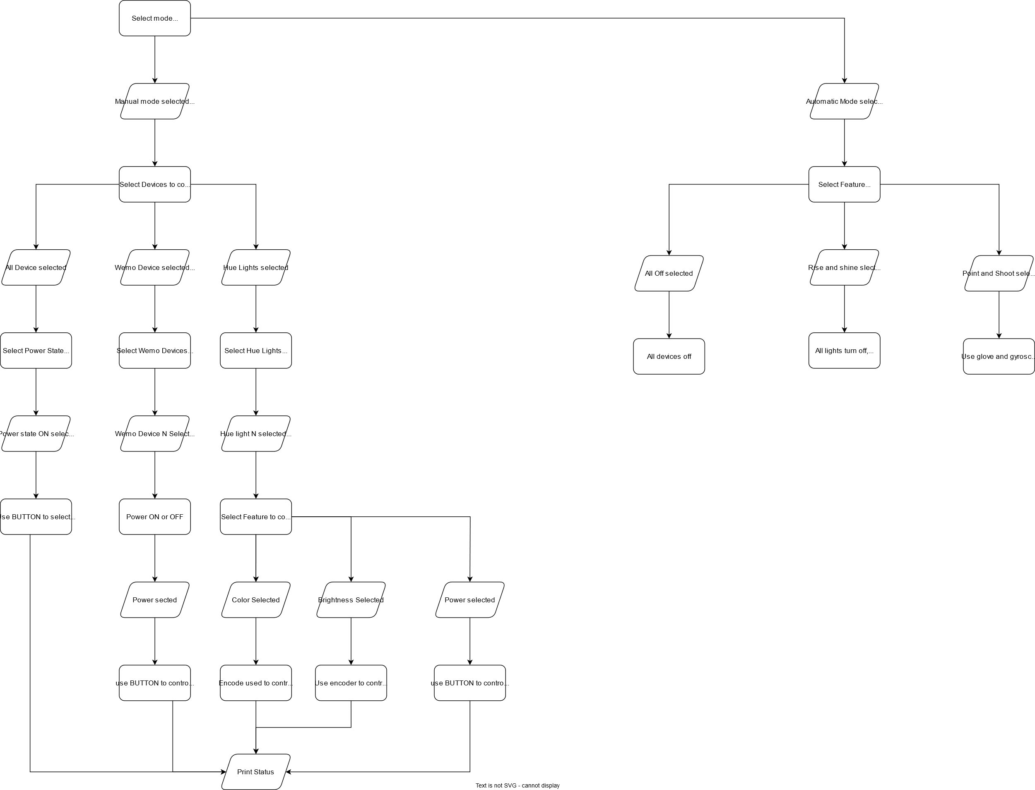
Menu Choice logic Basis for Menu screens

Slide 9
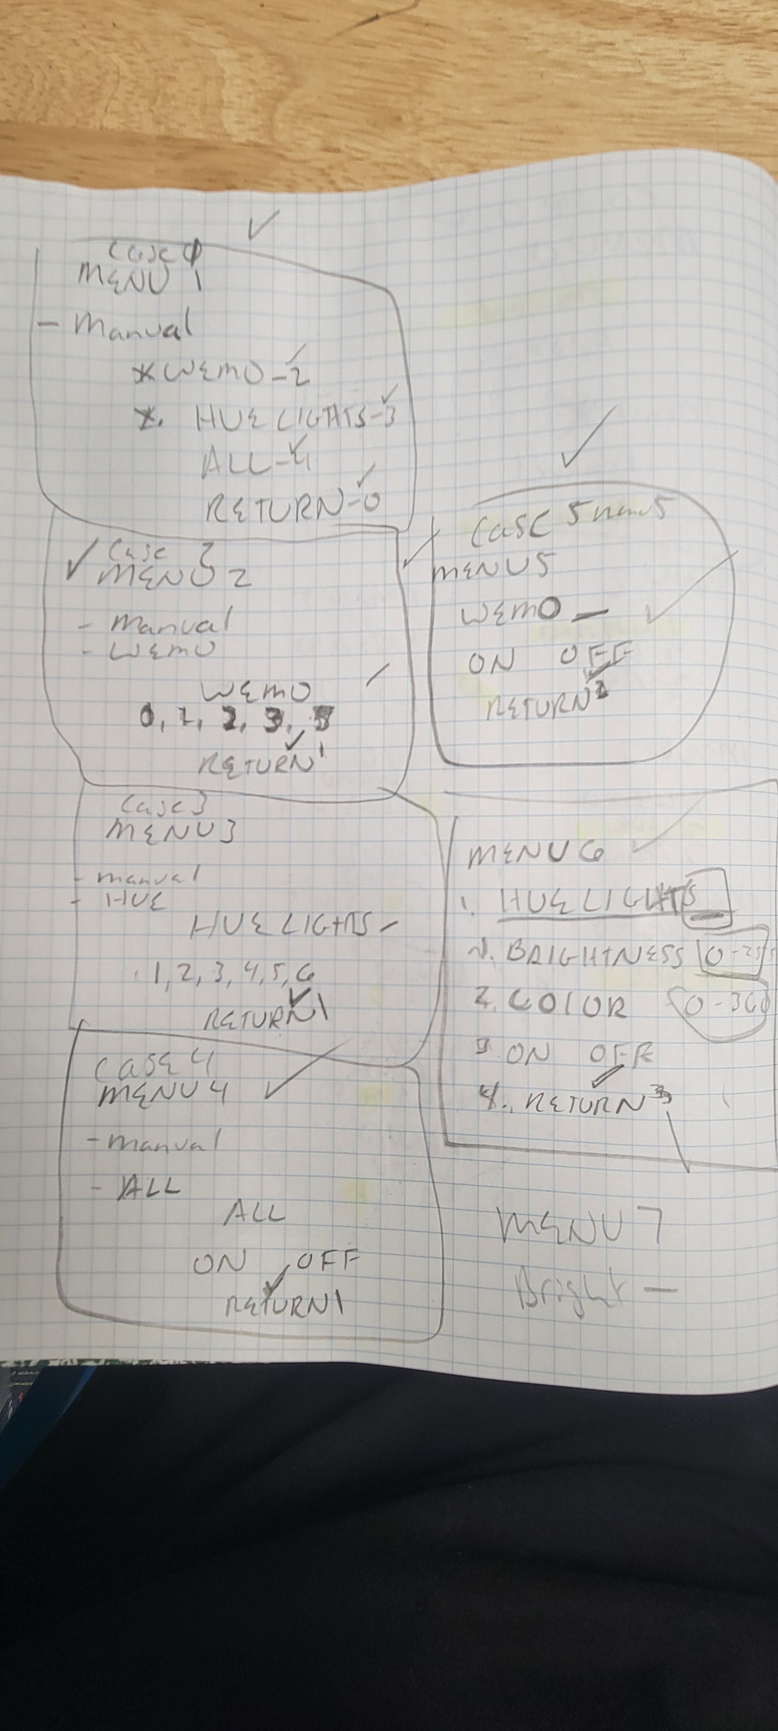
Real NOTES

Slide 10
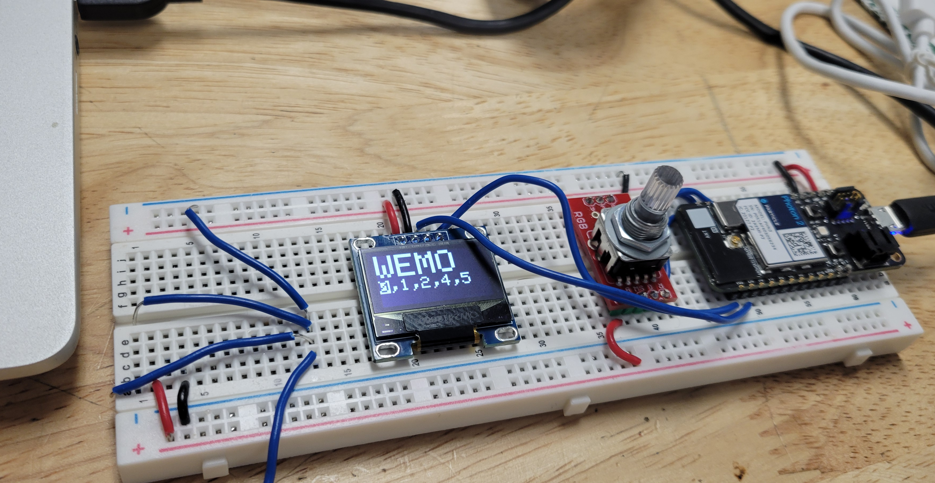
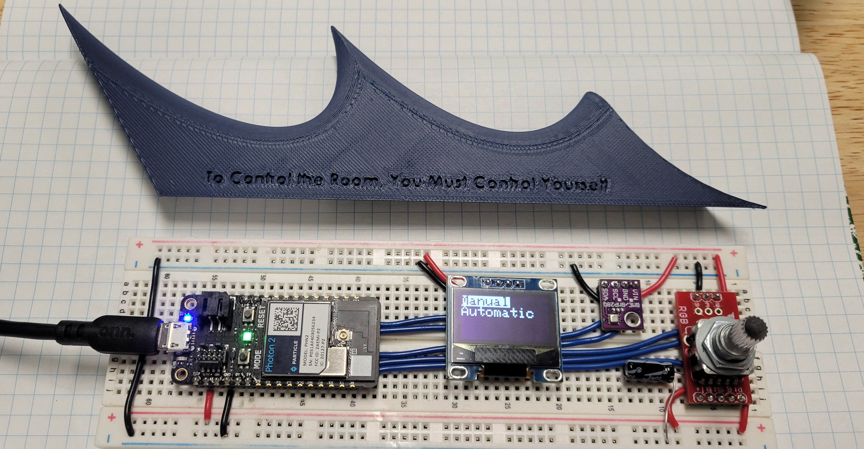
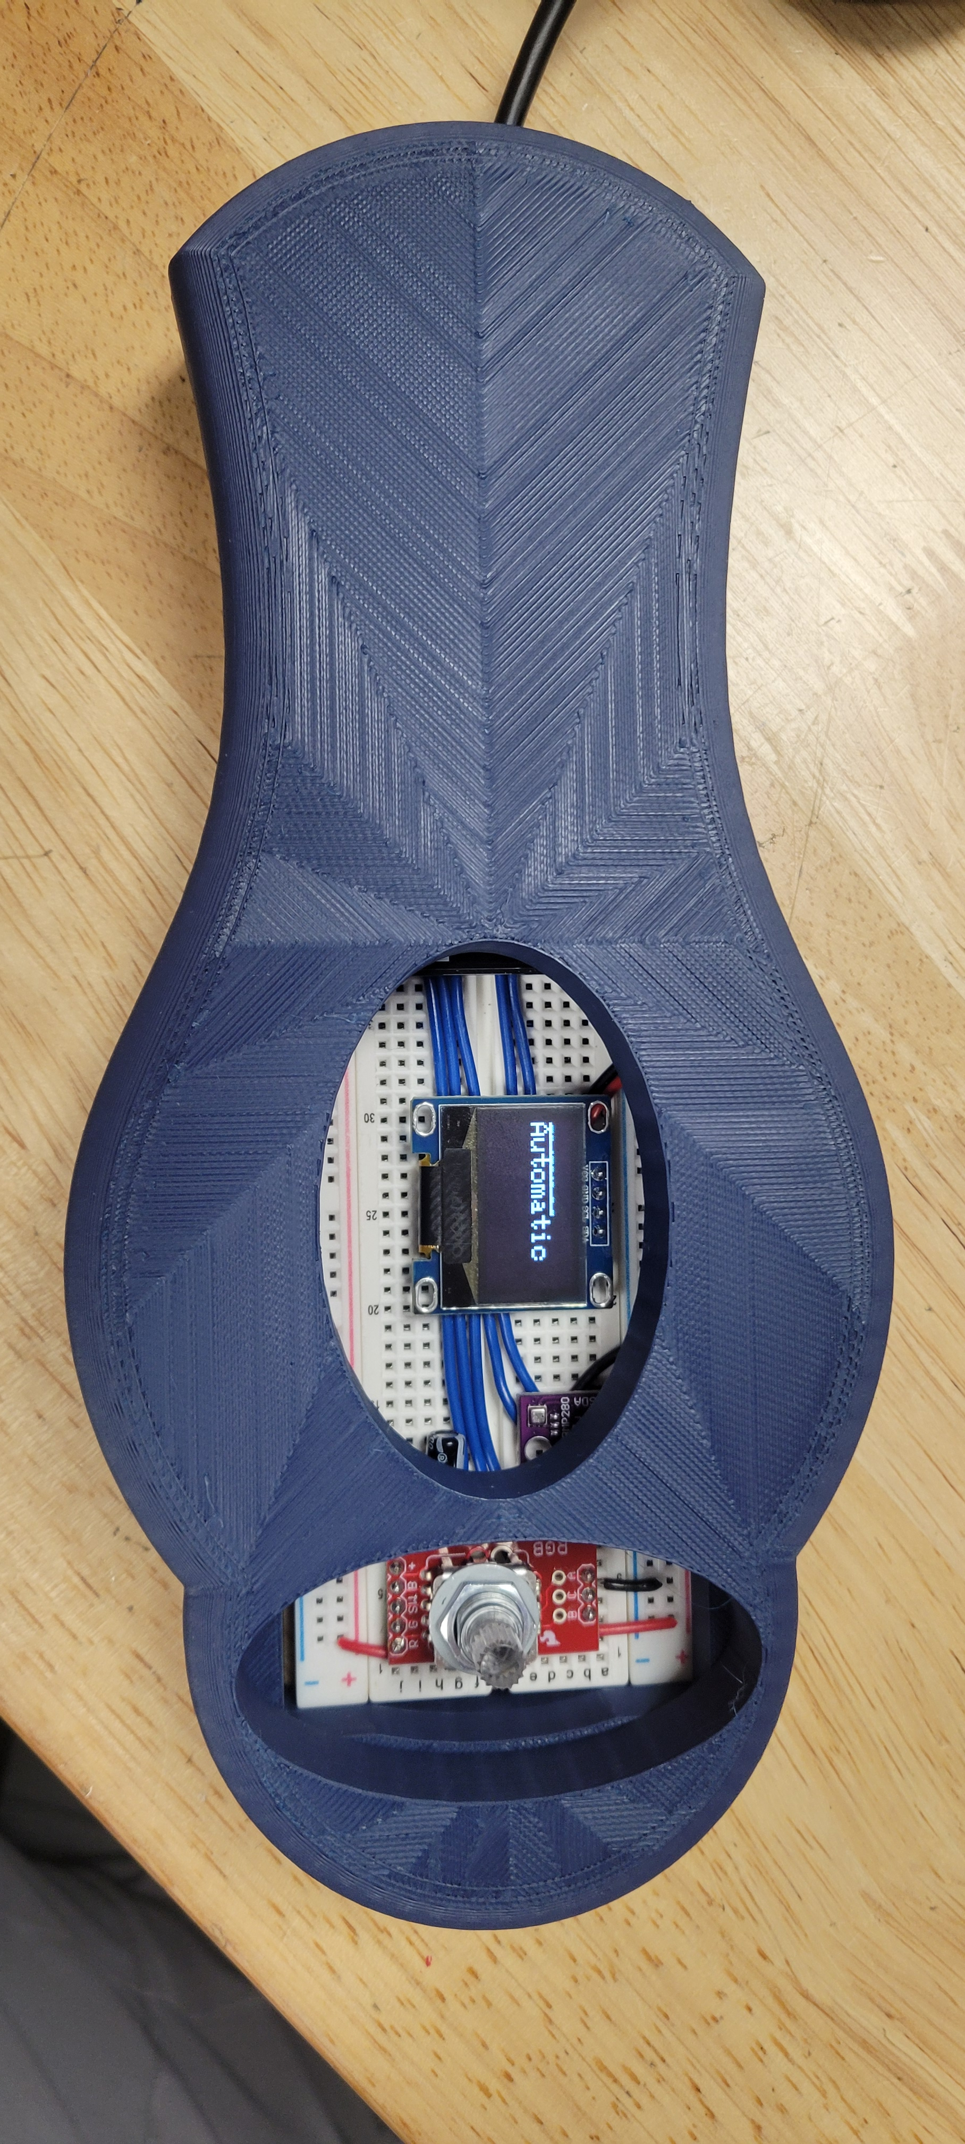
Design Process
Conception
Middle Design
Final Design
Basic idea of function
No layout
Not ergonomic
Component thought out
Exploring space to use
Cover for clean design
Was built to open- idea scratched

Slide 11
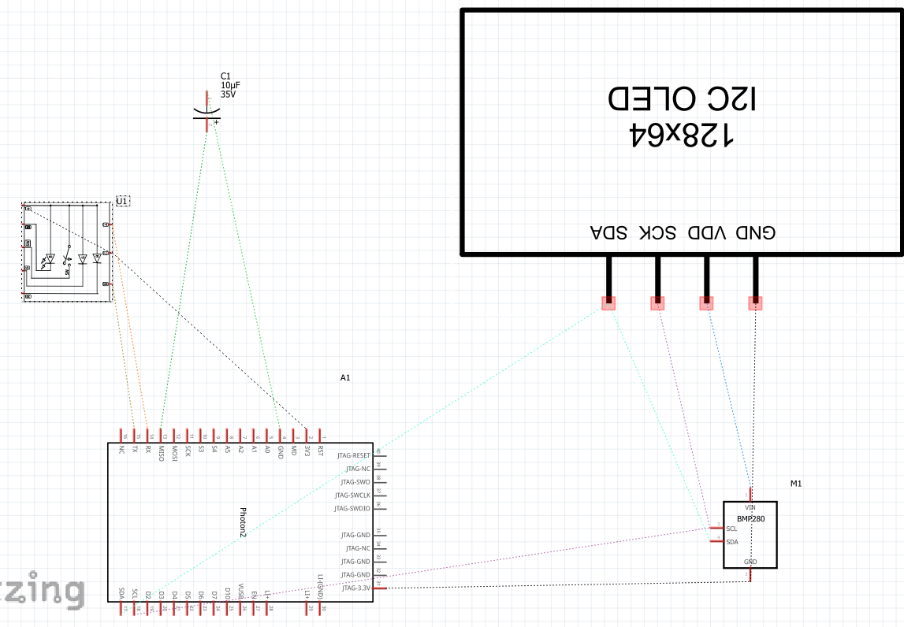

Slide 12
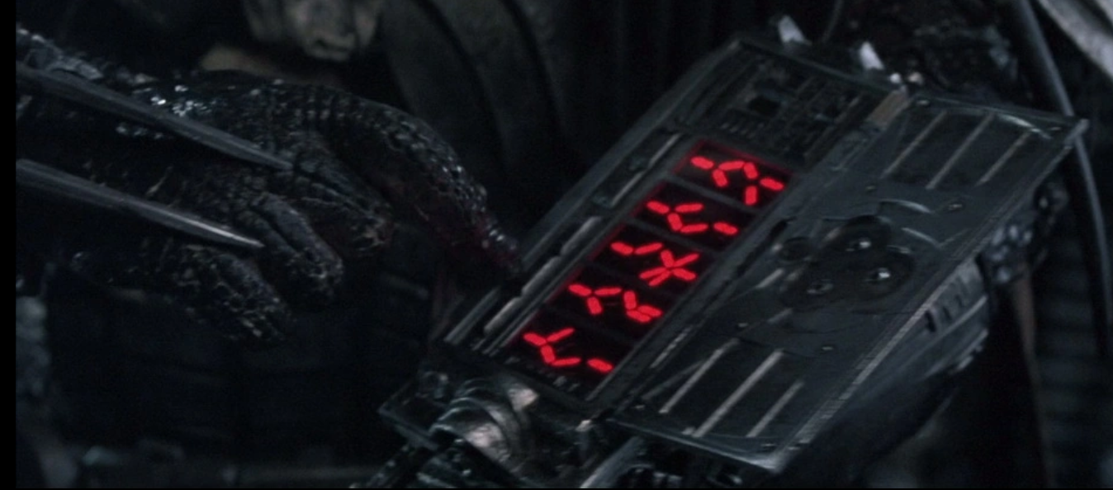
Version 2.0
Work on my lights at home
More Automation choices
Larger display screen
Blow up your spaceship

Slide 13
Questions?

Slide 14
Thank you
Thanks to Jeren, Nicole, Cesar and Ben
Funding inquires
Hackster.io https://www.hackster.io/kennethkinderwater/balance-the-room-782865
Github https://github.com/ken2water/IoT-Midterm-1
Email Kenneth Kinderwater

